Slide 1
Client-Side JavaScript
Ганболдын АМАРСАНАА
Мэдээлэл, компьютерийн ухааны тэнхим
МУИС, Хэрэглээний шинжлэх ухаан инженерчлэлийн сургууль
amarsanaag@num.edu.mn
ICSI301 Вэб програмчлал
2016 оны Хавар

Slide 2
Outline
JavaScript in Web Browsers
The Window object
Scripting Documents
Scripting CSS
Scripted HTTP
The jQuery Library

Slide 3
1. JavaScript in Web Browsers
Client-Side JavaScript
Embedding JavaScript in HTML
Execution of JavaScript Programs
Compatibility and Interoperability
Security – Same Policy Origin

Slide 4
JavaScript in Web Documents
A JavaScript program can traverse and manipulate document content through the Document object and the Element objects it contains.
can alter the presentation of that content by scripting CSS styles and classes
can define the behavior of document elements by registering appropriate event handlers
The combination of scriptable content, presentation, and behavior is called Dynamic HTML or DHTML
The proper role of JavaScript is to enhance a user’s browsing experience, making it easier to obtain or transmit information.
Create animations, Sort columns of table, Hide/show contents etc.

Slide 5
JavaScript in Web Applications
Web applications use
JavaScript DHTML features
content, presentation, and behavior manipulation APIs
services provided by web browsers
Operating System = Web browser
organizes files and applications
runs multiple applications in separate windows
low-level APIs for networking, drawing graphics, and saving files
organizes documents and web applications
displays multiple documents (or applications) in separate tabs
define low-level APIs for networking, saving data, and drawing graphics

Slide 6
Embedding JavaScript in HTML
four ways of embedding
Document script, between a pair of <script> and </script> tags
From an external file by the src attribute of a <script> tag
Inline, in an HTML event handler attribute, such as onclick or onmouseover
In a URL that uses the special javascript:protocol
old ways: event handler attribute, javascript: URL
less usage: document script
best way: external file
content (HTML) and behavior (JavaScript code) should as much as possible be kept separate

Slide 7
Scripts in External Files
keep content and behavior separate
sharing the same JavaScript code allows you to maintain only a single copy of that code, rather than having to edit each HTML file when the code changes
first page downloads JavaScript code and uses it —subsequent pages can retrieve it from the browser cache
one web server can employ code exported by other web servers
load scripts from other sites allows us to take the benefits of caching (a single copy for shared use by any site across the Web)
<script src="../../scripts/util.js"></script>

Slide 8
Execution of JavaScript Programs
JavaScript program consists of all the JavaScript code in a web page
share a single global Window object
see the same Document object
share the same set of global functions and variables
<iframe> - a separate JavaScript program
Two phases of execution
Loads the script
Runs the script
asynchronous and event-driven
load event says that the document is fully loaded and ready to be manipulated
this event as a trigger or starting signal
Events are invoked in response to user input, network activity, elapsed time, or errors

Slide 9
Synchronous, Asynchronous, and Deferred Scripts
synchronous or blocking script execution is the default
defer and async boolean attributes changes execution
<script defer src="deferred.js"></script>
<script async src="async.js"></script>
linked script does not use document.write() and will not generating document content
browser can continue to parse and render the document while downloading the script
defer - to defer execution of the script until after the document has been loaded and parsed and is ready to be manipulated
async - to run the script as soon as possible but not to block document parsing while the script is being downloaded (may execute out of order)
Notes:
The HTML parser runs <script> before resume parsing and rendering the document.

Slide 10
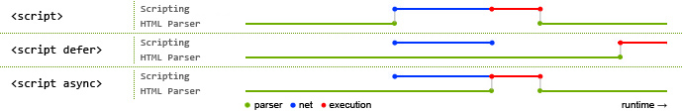
Asynchronous and deferred execution explained

Slide 11
Event-Driven JavaScript
Event handler functions are invoked asynchronously
the simplest way to register an event handler is usually to assign a JavaScript function to a property of the target object
window.onload = function() { ... };
document.getElementById("button1").onclick = function() { ... };
function handleResponse() { ... }
request.onreadystatechange = handleResponse;
Events elements in a document often propagate up the document tree in a process known as “bubbling.”
addEventListener() allows the registration of multiple listeners (attachEvent for IE8 and earlier)
window.addEventListener("load", function() {...}, false);
request.addEventListener("readystatechange", function() {...}, false);

Slide 12
Event-Driven JavaScript (2)
setTimeout() and setInterval() functions trigger the invocation of a specified function after a specified amount of time.
called “callbacks” instead of “handlers”
asynchronous just as event handlers are
general-purpose functions and don’t really have anything to do with the window
setInterval(updateClock, 60000); // Call updateClock() every 60 seconds
clearTimeout() to cancel the execution of the scheduled function
clearInterval() to cancel any future invocations of the scheduled function
Notes:
setTimeout(expression, timeout); runs the code/function once after the timeout.
setInterval(expression, timeout); runs the code/function in intervals, with the length of the timeout between them.

Slide 13
Client-Side JavaScript Threading Model
The core JavaScript language does not contain any threading mechanism
No worry about locks, deadlock, or race conditions on concurrent execution
It stops responding to user input while scripts and event handlers are executing
JavaScript scripts and event handlers are not for computationally intensive task (may cause nonresponsive or crashed)
Advice:
Load document fully before performing that computation
Notify the user that computation is underway
break your computation down into discrete subtasks
setTimeout()and setInterval()to run the subtasks in the background
HTML5 defines a controlled form of concurrency called a “web worker.” No access Window or Document object.
Notes:
A web worker is a background thread for performing computationally intensive tasks without freezing the user interface.
It can communicate with the main thread only through asynchronous message passing (Events).
No concurrent modifications of the DOM!

Slide 14
Client-Side JavaScript Timeline
creates a Document object and begins parsing the web page (document.readyState = “loading”)
HTML parser executes <script> synchronously and pauses while the script downloads and runs
When parser encounters a <script async>, it begins downloading the script text and continues parsing the document
When the document is completely parsed, the document.readyState property changes to “interactive”.
Any <script defer> are executed in the order in which they appeared in the document. Async scripts may also be executed at this time.
DOMContentLoaded event on the Document object is invoked.
synchronous script execution phase -> asynchronous event-driven phase
The document is completely parsed at this point (still waiting additional content). When all contents are loaded, and when all async scripts have executed, the document.readyStateproperty changes to “complete” and load event on the Window object is fired.
From this point on, event handlers are invoked asynchronously

Slide 15
Compatibility and Interoperability
three general categories
Evolution - A standards body proposes a new feature or API (New feature and large number of visitors)
Non-implementation - browser vendors differ in their opinions of whether a particular feature is useful enough to implement (e.g., IE8 does not support the <canvas>, DOM Level 2 Events specification)
Bugs - Every browser has bugs, and none implement all of the client-side JavaScript APIs exactly as specified.
JavaScript language itself is interoperably implemented by all browser vendors!

Slide 16
Feature Testing
Feature testing (sometimes called capability testing) is a powerful technique for coping with incompatibilities.
if (element.addEventListener) { // Test for this W3C method before using it
element.addEventListener("keydown", handler, false);
element.addEventListener("keypress", handler, false);
}
// Test for this IE method before using it
else if (element.attachEvent) {
element.attachEvent("onkeydown", handler);
element.attachEvent("onkeypress", handler);
}
else { // Otherwise, fall back on a universally supported technique
element.onkeydown = element.onkeypress = handler;
}

Slide 17
Conditional Comments in Internet Explorer
<!--[if IE 6]>
This content is actually inside an HTML comment.
It will only be displayed in IE 6.
<![endif]-->
<!--[if lte IE 7]>
This content will only be displayed by IE 5, 6 and 7 and earlier.
lte stands for "less than or equal". You can also use "lt", "gt" and "gte".
<![endif]-->
<!--[if !IE]> <-->
This is normal HTML content, but IE will not display it
because of the comment above and the comment below.
<!--> <![endif]-->
This is normal content, displayed by all browsers.

Slide 18
Security
browser vendors have worked hard to balance two competing goals:
Defining powerful client-side APIs to enable useful web applications.
Preventing malicious code from reading or altering your data, compromising your privacy, scamming you, or wasting time.

Slide 19
What JavaScript Can’t Do?
cannot access file system (cannot delete data or plant viruses)
does not have any general-purpose networking capabilities (except HTTP protocol, WebSockets - socket-like API for communicating with specialized servers)
new browser windows can happen only in response to a user-initiated events, such as mouse click
A JavaScript program can close browser windows that it opened itself, but it is not allowed to close other windows without user confirmation.
The value property of HTML FileUpload elements cannot be set.
A script cannot read the content of documents loaded from different servers than the document that contains the script.
A script cannot register event listeners on documents from different servers.

Slide 20
The Same-Origin Policy
The same-origin policy is a security restriction on what web content JavaScript code can interact with.
It happens when loads <iframe> elements or opens other browser windows
A script can read only the properties of windows and documents that have the same origin as the document that contains the script
The origin of a document is defined as the protocol, host, and port of the URL
Different origins:
Different host
Different ports of the same host
Different protocols of same host
origin of the script itself is not relevant to the same-origin policy e.g., <script src=“http://code.jquery.com/jquery-1.11.0.min.js”></script>

Slide 21
DOM (Document Object Model)
You can attach event handlers to HTML elements with very little knowledge of the DOM
However, to change what is displayed on the page requires knowledge of how to refer to the various elements
The basic DOM is a W3C standard and is consistent across various browsers
More complex features are browser-dependent
The highest level element (for the current page) is window, and everything else descends from that
Every JavaScript variable is a field of some object
In the DOM, all variables are assumed to start with “window.”
All other elements can be reached by working down from there

Slide 22
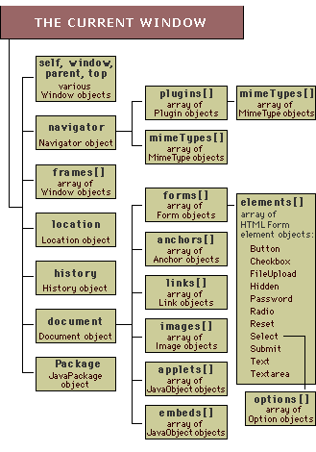
The DOM hierarchy
Source: http://sislands.com/coin70/week1/dom.htm

Slide 23
window properties/fields
window
The current window (not usually needed).
self
Same as window.
parent
If in a frame, the immediately enclosing window.
top
If in a frame, the outermost enclosing window.
frames[ ]
An array of frames (if any) within the current window. Frames are themselves windows.
length
The number of frames contained in this window.

Slide 24
window properties/fields [2]
document
The HTML document being displayed in this window.
location
The URL of the document being displayed in this window. If you set this property to a new URL, that URL will be loaded into this window. Calling location.reload() will refresh the window.
navigator
A reference to the Navigator (browser) object. Some properties of Navigator are:
appName -- the name of the browser, such as "Netscape"
platform -- the computer running the browser, such as "Win32"
status
A read/write string displayed in the status area of the browser window. Can be changed with a simple assignment statement.

Slide 25
2. The Window object
The Window object is the main entry point to all client-side JavaScript features and APIs.
load a new URL into the window
window.location = “http://num.edu.mn”;
register a function to be invoked after a specified amount of time
setTimeout(function() { alert("hello world"); }, 2000);
Window object is also the global object
Top of the scope chain
Properties and methods are effectively global variables and global functions
window.document – a Document object that represents the content displayed in the window

Slide 26
Browser Location and Navigation
window.location === document.location
refers to a Location object, which represents the current URL of the document displayed in the window,
document.URL – read only
Parsing URLs: Extracting arguments from the search string of a URL
function urlArgs() {
var args = {}; // Start with an empty object
var query = location.search.substring(1); // Get query string, minus '?'
var pairs = query.split("&"); // Split at ampersands
for(var i = 0; i < pairs.length; i++) { // For each fragment
var pos = pairs[i].indexOf('='); // Look for "name=value"
if (pos == -1) continue; // If not found, skip it
var name = pairs[i].substring(0,pos); // Extract the name
var value = pairs[i].substring(pos+1); // Extract the value
value = decodeURIComponent(value); // Decode the value
args[name] = value; // Store as a property
}
return args; } // Return the parsed arguments

Slide 27
Loading New Documents
replace or assign method
if (!XMLHttpRequest) location.replace("staticpage.html");
Absolute URL
location = "http://www.oreilly.com"; // Go buy some books!
Relative URL
location = "page2.html"; // Load the next page by relative URL
Document section
location = "#top"; // Jump to the top of the document
By passing query string
location.search = "?page=" + (pagenum+1); // load the next page

Slide 28
Browsing History
window.history refers to the History object for the window
models the browsing history of a window as a list of documents and document states
window.history.length specifies the number of elements in the browsing history list
back() and forward() methods like the browser’s Back and Forward buttons
history.go(); takes an integer argument and can skip any number of pages forward (for positive arguments) or backward (for negative arguments) in the history list
If a window contains child windows (frames), the child windows goes into the history.

Slide 29
The Navigator Object
window.navigator refers to the Navigator object that that contains browser vendor and version number information
appName - The full name of the web browser
appVersion - browser vendor and version information
userAgent - The string that the browser sends in its USER-AGENT HTTP header
Platform - A string that identifies the operating system
Additionally,
online - specifies whether the browser is currently connected to the network
geolocation - A Geolocation object that defines an API for determining the user’s geographical location.

Slide 30
Error handling
window.onerror is error handler that is invoked when an uncaught exception
// Display error messages in a dialog box, but never more than 3
window.onerror = function(msg, url, line) {
if (onerror.num++ < onerror.max) {
alert("ERROR: " + msg + "\n" + url + ":" + line);
return true;
}
}
onerror.max = 3;
onerror.num = 0;
try/catch exception handling statement is best choice

Slide 31
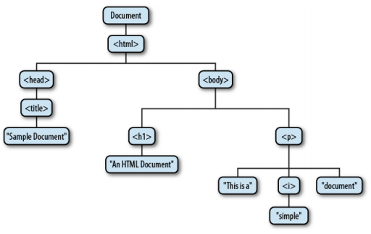
3. Scripting Documents
The Document Object Model, or DOM, is the fundamental API for representing and manipulating the content of HTML and XML documents.
<html>
<head>
<title>Sample Document</title>
</head>
<body>
<h1>An HTML Document</h1>
<p>This is a <i>simple</i> document.
</html>

Slide 32
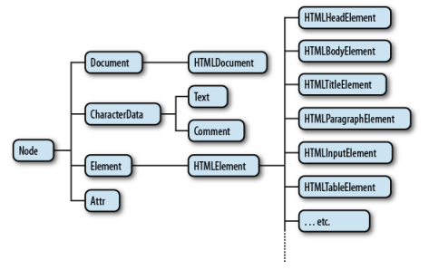
A partial class hierarchy of document nodes

Slide 33
Selecting Document Elements
id attribute
document.getElementById("section1");
name attribute
var rbuttons = document.getElementsByName("favorite_color");
tag name
var spans = document.getElementsByTagName("span");
CSS class or classes
var warnings = document.getElementsByClassName("warning");
CSS selector
querySelector() and querySelectorAll()

Slide 34
Document Structure and Traversal
Documents As Trees of Nodes
parentNode - The Node that is the parent of this one
childNodes - A read-only array-like object
firstChild, lastChild - The first and last child nodes of a node
nextSibling, previousSibling - The next and previous sibling node of a node.
nodeType - The kind of node this is (Element node 1, Text node 3)
nodeValue - The textual content of a Text or Comment node.
nodeName - The tag name of an Element, converted to uppercase.
For example,
document.childNodes[0].childNodes[1];
document.firstChild.firstChild.nextSibling;

Slide 35
Document Structure and Traversal
Documents As Trees of Elements
firstElementChild, lastElementChild - Like firstChildand lastChild, but for Element children only
nextElementSibling, previousElementSibling - Like nextSiblingand previousSibling, but for Element siblings only
childElementCount - The number of element children. Returns the same value as children.length.

Slide 36
Creating, Inserting, and Deleting Nodes
// Asynchronously load and execute a script from a specified URL
function loadasync(url) {
var head = document.getElementsByTagName("head")[0];
var s = document.createElement("script"); s.src = url;
head.appendChild(s);
}
Removing and Replacing Nodes
n.parentNode.removeChild(n);
n.parentNode.replaceChild( document.createTextNode("[ REDACTED ]"), n);

Slide 37
4. Scripting CSS
CSS styles can be scripted
Scripted CSS enables a variety of interesting visual effects
animated transitions where document content “slides in” from the right
expanding and collapsing outline list
the most important features of CSS are the properties that specify the visibility, size, and precise position of individual elements of a document

Slide 38
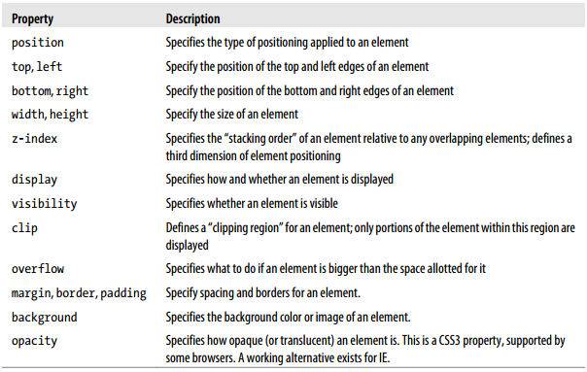
Important CSS Properties

Slide 39
Scripting Inline Styles
Alter style attribute of individual document elements
e.style.position = "absolute";
e.style.fontFamily = "sans-serif";
e.style.backgroundColor = "#ffffff";
e.style.left = (x0+left_margin+left_border+left_padding) + "px";
style is CSSStyleDeclaration object
all values must be specified as strings
The style attribute of an HTML element is its inline style (overrides any style)
Or, using Element getAttribute() and setAttribute() methods, or use the cssText property of the CSSStyleDeclaration object
The most common uses of scripted CSS is to produce animated visual effects
by using setTimeout()or setInterval()
for querying the styles window.getComputedStyle(element, null);

Slide 40
Scripting CSS Classes and Stylesheets
Changing an element’s class changes the set of stylesheet selectors that apply to the element
e.className = "attention"; // applying
e.className = ""; // releasing
the class attribute holds a space-separated list of class names
two kinds of objects for scripting stylesheets
<style> and <link> elements
CSSStyleSheet object (document.styleSheets property is a read-only array-like object)
document.styleSheets[ss].disabled = true;
var firstRule = document.styleSheets[0].cssRules[0];
document.styleSheets[0].insertRule("H1 { text-weight: bold; }", 0);
For IE, addRule instead of insertRule

Slide 41
5. Scripted HTTP
Ajax describes an architecture for web applications that prominently features scripted HTTP
data exchange with a web server without causing pages to reload
more like traditional desktop applications
Comet refers to a related web application architecture that uses scripted HTTP
the reverse of Ajax
web server initiates the communication, asynchronously sending messages to the client
Ajax responds to these messages
client to establish a connection to the server (using an Ajax transport) and for the server to keep this connection open until it needs to push a message.
Each time the server sends a message, it closes the connection, which means message is properly received by the client.
After processing the message, the client then immediately establishes a new connection for future messages

Slide 42
Encoding the Request Body
Form-encoded requests (GET, POST)
E.g., find=pizza&zipcode=02134&radius=1km
formal MIME type: application/x-www-form-urlencoded
set the “Content-Type” request header
{
find: "pizza",
zipcode: 02134,
radius: "1km"
}
function encodeFormData(data) {
var pairs = []; // To hold name=value pairs
for(var name in data) { // For each name
var value = data[name].toString(); // Value as string
name = encodeURIComponent(name.replace(" ", "+")); // Encode name
value = encodeURIComponent(value.replace(" ", "+")); // Encode value
pairs.push(name + "=" + value); // Remember name=value pair
}
return pairs.join('&'); // Return joined pairs separated with &
}

Slide 43
Encoding the Request Body (2)
JSON-encoded requests
encode a request body using JSON.stringify()
function postJSON(url, data, callback) {
var request = new XMLHttpRequest();
request.open("POST", url); // POST to the specified url
request.onreadystatechange = function() {
if (request.readyState === 4 && callback)
callback(request); // call the callback.
};
request.setRequestHeader("Content-Type", "application/json");
request.send(JSON.stringify(data));
}

Slide 44
Encoding the Request Body (3)
XML-encoded requests
represent it as an XML document
<query><find zipcode="02134" radius="1km">pizza</find></query>
function postQuery(url, what, where, radius, callback) {
var request = new XMLHttpRequest(); request.open("POST", url); request.onreadystatechange = function() { if (request.readyState === 4 && callback) callback(request);
};
var doc = document.implementation.createDocument("", "query", null); var query = doc.documentElement; var find = doc.createElement("find"); query.appendChild(find); find.setAttribute("zipcode", where); find.setAttribute("radius", radius); find.appendChild(doc.createTextNode(what)); request.send(doc);
}

Slide 45
Cross-Origin HTTP Requests
issue HTTP requests only to the server from which the document that uses it was downloaded
can use cross-origin URLs with <form> and <iframe> elements
the same-origin policy cannot allow XMLHttpRequest to make cross origin requests
XHR2 allows cross-origin requests to websites that opt-in by sending appropriate CORS (Cross-Origin Resource Sharing) headers in their HTTP responses
Browser: Origin: http://www.example.com
Server: Access-Control-Allow-Origin: http://network.com

Slide 46
JSON (JavaScript Object Notation)
JSON is a lightweight data-interchange format.
easy for humans to read and write.
easy for machines to parse and generate.
subset of the JavaScript Programming Language
JSON is built on two structures
A collection of name/value pairs. In various languages, this is realized as an object, record, struct, dictionary, hash table, keyed list, or associative array.
An ordered list of values. In most languages, this is realized as an array, vector, list, or sequence.
universal data structures
{
find: "pizza",
zipcode: 02134,
radius: "1km"
}

Slide 47
HTTP by <script>: JSONP
simply set the src attribute of a <script> and the browser will generate an HTTP request to download the URL
surrounding it with parentheses and prefixing it with the name of a JavaScript function
handleResponse(
[1, 2, {"buckle": "my shoe"}]
)
Instead of direct sending
[1, 2, {"buckle": "my shoe"}]
<script type="application/javascript"
src="http://example.com/Users/1234?jsonp=parseResponse">
</script>

Slide 48
JQuery
http://www.webstepbook.com/supplements-2ed/slides/lectureXX-jquery.shtml

